Slide 1
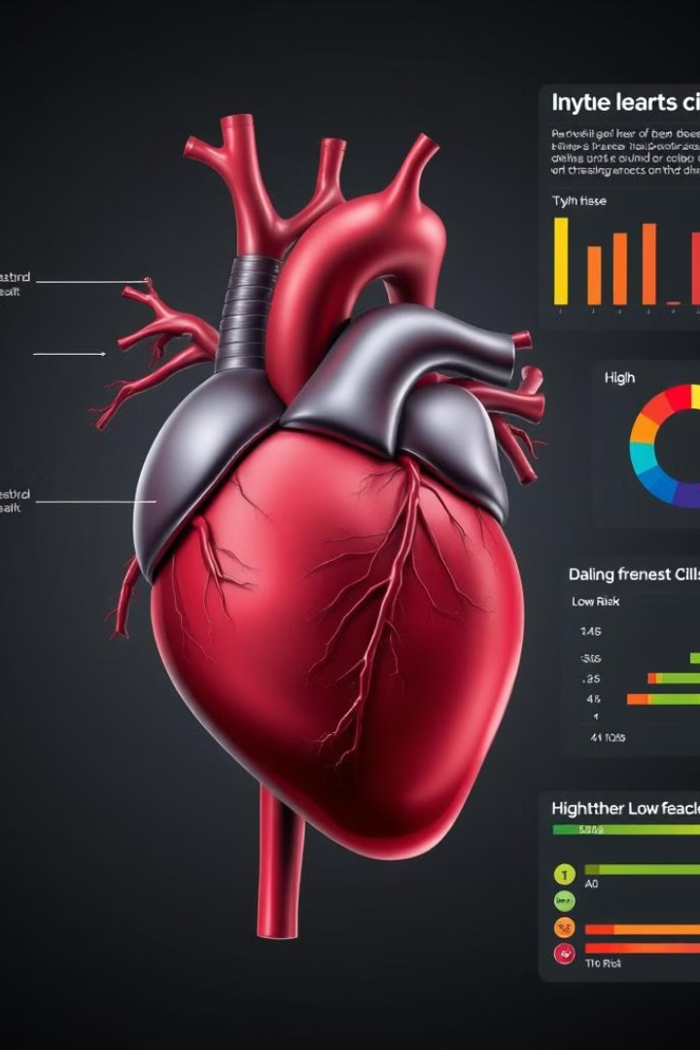
Face Mask Detection using CNN
This presentation explores the application of machine learning to detect face mask using CNN.
HARSH RATHORE - E23CSEU0660
JAYESH ARORA - E23CSEU0648

Slide 2
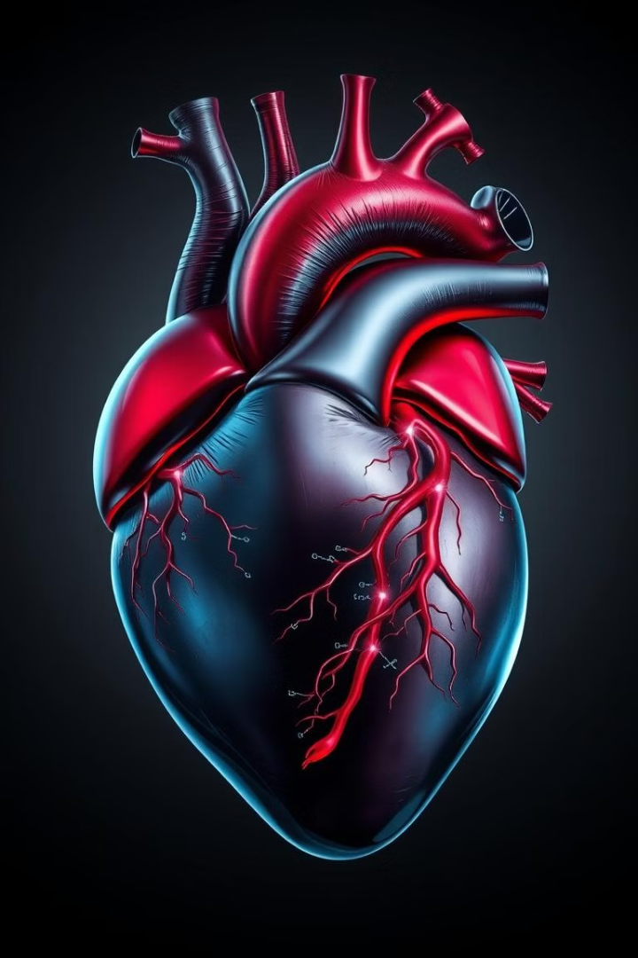
Introduction to Face Mask Detection
1
Overview
2
Importance
Face mask detection involves using computer vision to determine whether individuals are wearing masks, which is essential for public safety and compliance during pandemics.
Ensuring mask usage in crowded areas helps control the spread of airborne diseases, such as COVID-19.
3
Technology
Convolutional Neural Networks (CNNs) form the backbone of mask detection systems, providing efficient and accurate image classification.

Slide 3

Data Collection and Preprocessing
Data Sources
1
Data for mask detection can be obtained from publicly available datasets (e.g., Kaggle, AIZOO) or custom image collections.
2
Data Cleaning
Includes removing low-quality images, addressing noise, and balancing mask vs. non-mask classes.
Data Augmentation
3
Techniques like rotation, flipping, and brightness
adjustment enhance the dataset for robust model training.

Slide 4

Feature Extraction and CNN Architecture
Convolutional Layers
Pooling Layers
Extract features such as edges, textures, and shapes from the image.
Reduce feature map size while retaining important information, improving efficiency.
Fully Connected Layers
Activation Functions
Combine features into high-level predictions (mask or no mask).
Use ReLU for non-linear transformations and softmax for classification.

Slide 5
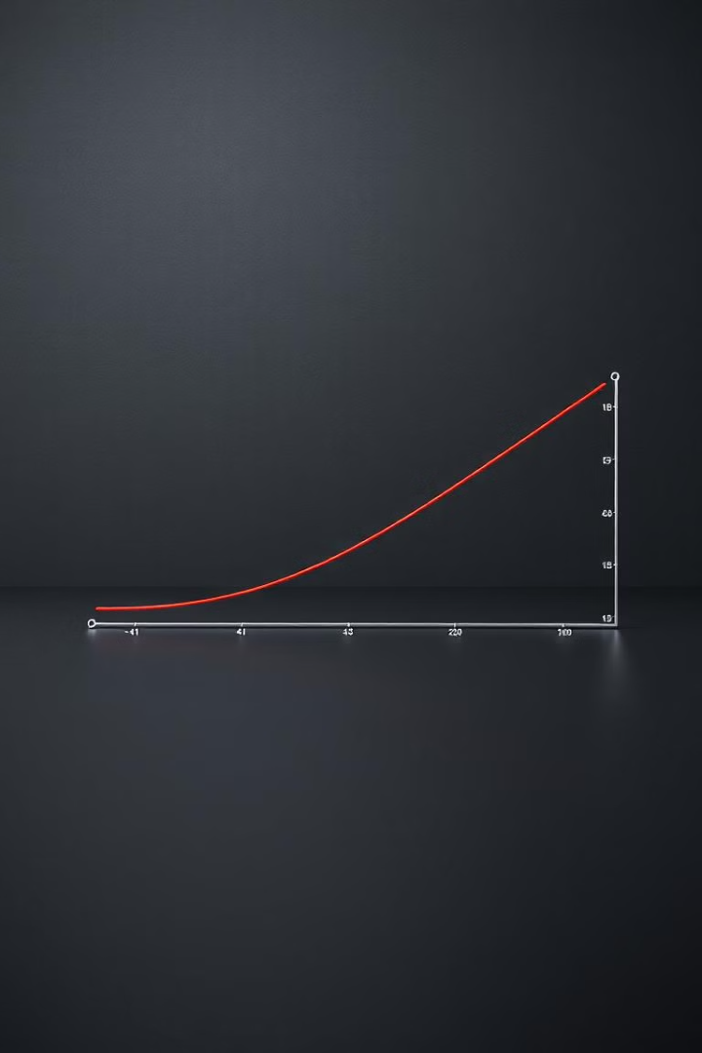
Implementation and Training
Frameworks
Libraries like TensorFlow and PyTorch streamline model development and deployment.
Loss Function
Cross-entropy loss measures prediction errors during training.
Optimization
Techniques like Adam and SGD optimize model performance.
Evaluation
Metrics include accuracy, precision, recall, and F1-score to assess classification success.

Slide 6
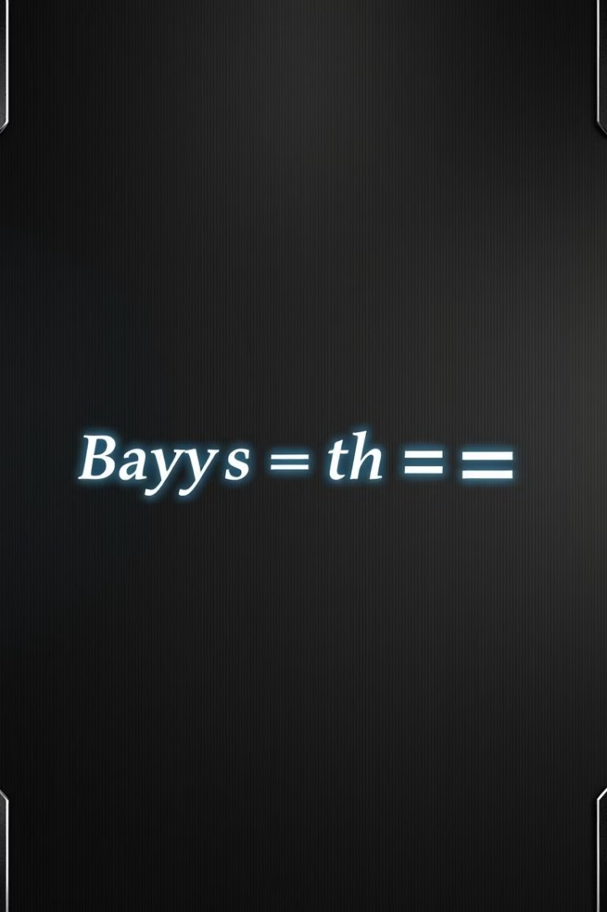
Model Deployment
Deploy the model in environments like CCTV systems or mobile apps for live monitoring.
Choose edge processing for low latency or cloud-based systems for scalability.
Combine with alert systems or dashboards to enhance utility.

Slide 7

Future Scope and Challenges
Scalability
Expand to detect other safety equipment like helmets or gloves.
Challenges
Address occlusions, diverse lighting conditions, and cultural variations in mask design.
Advancements
Use advanced architectures like MobileNet or EfficientNet for lightweight applications.

Slide 8

Principle of CNN
1
Inspiration
2
Key Components
CNNs are inspired by the human visual system, specifically the way the brain processes visual information.
Convolutional Layers
Pooling Layers
Fully Connected Layers
Working Mechanism
4
Applications in Face
Mask Detection
3
Convolution Operation
Activation Function
Backpropagation
Detects visual patterns (mask shapes, textures).
Classifies images as "Mask" or "No Mask" using learned features.

Slide 9
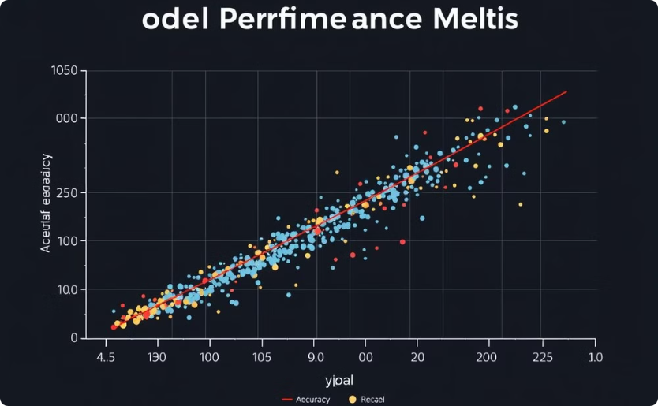
Model Evaluation
Performance Metrics
Assess model accuracy, precision, recall, and other metrics to evaluate its performance.

Slide 10
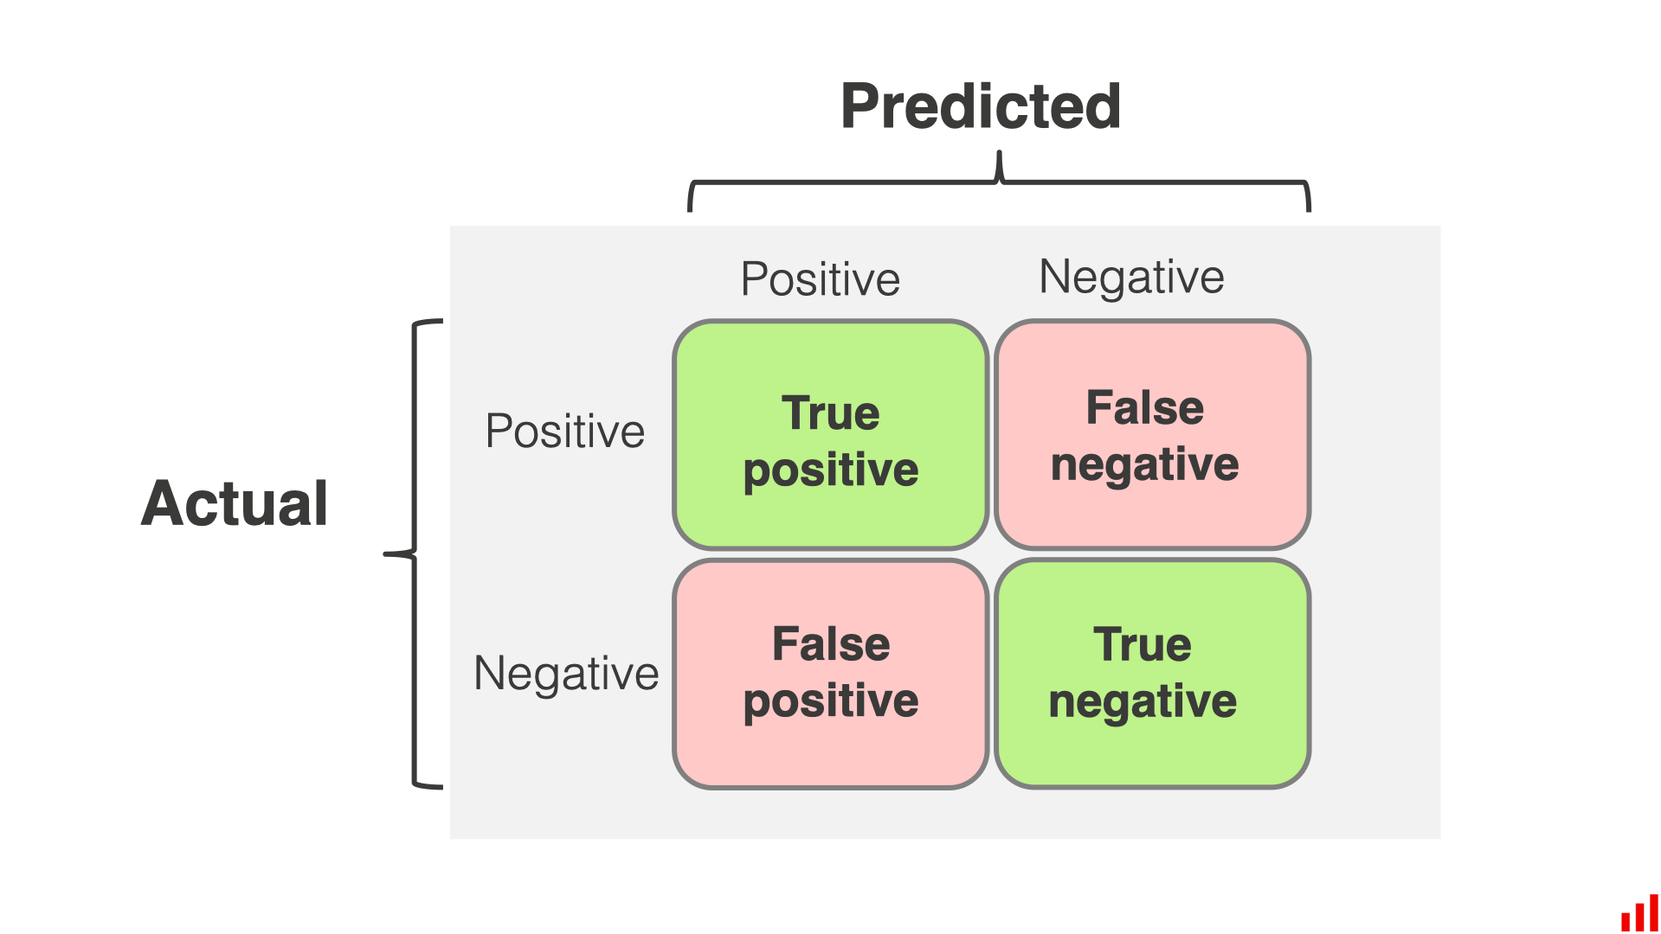




Comparison Metrics: F1-Score, Accuracy, Specificity, Precision, Recall
Accuracy
Precision
Percentage of correct predictions.
Percentage of positive predictions that were correct.
Recall
F1-Score
Percentage of actual positive cases that were correctly predicted.
Harmonic mean of precision and recall.

